Slide 1


GOLD YOUTH
IMPACT MANAGEMENT CAPABILITY
ASSESSMENT
REPORT
RELATIV IMPACT
APRIL 2024

Slide 2
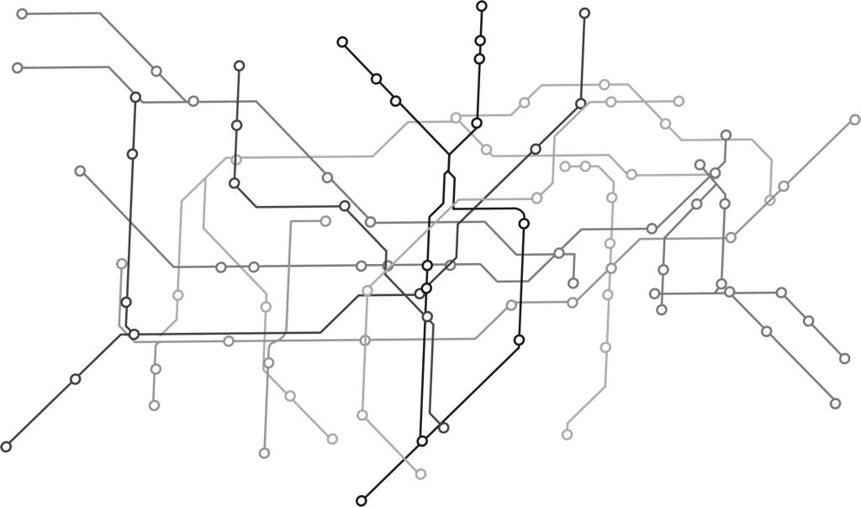
Contents
01
Introduction
02
Results: Overview
03
Results and Recommendations
04
Next Steps
Capability ASSESSMENT Report

Slide 3
INTRODUCTION
1

Slide 4
Introduction
Thank you for embarking on this journey of discovery and development with us.
We trust the process in itself will be valuable and help facilitate and stretch your thinking on Impact Management, its role within your organization, and how maturing this capability in and across your organization can support more effective achievement of your impact goals and objectives.
This report is is based on your completion of the Impact Management Capability Assessment Survey. It is intended to give you a ‘point-in-time’ view of where you are currently, and what key actions you can take to further progress on your journey towards maturity and optimizing the value you can derive from Impact Management as a capability.
The core of the report includes the results of your Capability Assessment Survey at a high-level with a summary roadmap of potential actions, followed by a more detailed view of your results per dimension and the elements which make up each dimension of impact management as a capability. Each results section includes recommendations for key actions you can take.
It is important to note that developing and maturing a new capability is a journey, one that takes time and is likely to be ever-changing in line with the dynamic context and environment in which you work. The typical nature of organizational maturing, means you are likely to experience cycles of maturing and triggers that will prompt refinements and adaptations over time, rather than a single linear progression from a static point. So, continue to review progress, prioritize actions, and celebrate milestones in cycles along the way.
You will be able to complete the Impact Management Capability Assessment Survey multiple times in the future to track and review your progress over time, as well as to set new plans of actions to further mature in the future.
Capability ASSESSMENT Report

Slide 5

Shifts
Current and future state is considered to identify required shifts in key areas of the organisation’s impact management capability. These shifts can be used to develop an action plan (development path) to close gaps in each dimension.
GAP
CURRENT STATE
SHIFTS
DESIRED STATE
Unpack what is your current state of this capability per dimension
Pin-point the shifts we need to make to realise your ideal state in each dimension
Ideal future state is considered to be ‘mature’ in each dimension
Complete the Impact Management Capability Assessment
Automated assessment of gaps and recommended actions to close gaps and enhance maturity
Implemented recommended actions to close gaps and enhance maturity
Capability maturity model

Slide 6
Results : Overview
2

Slide 7
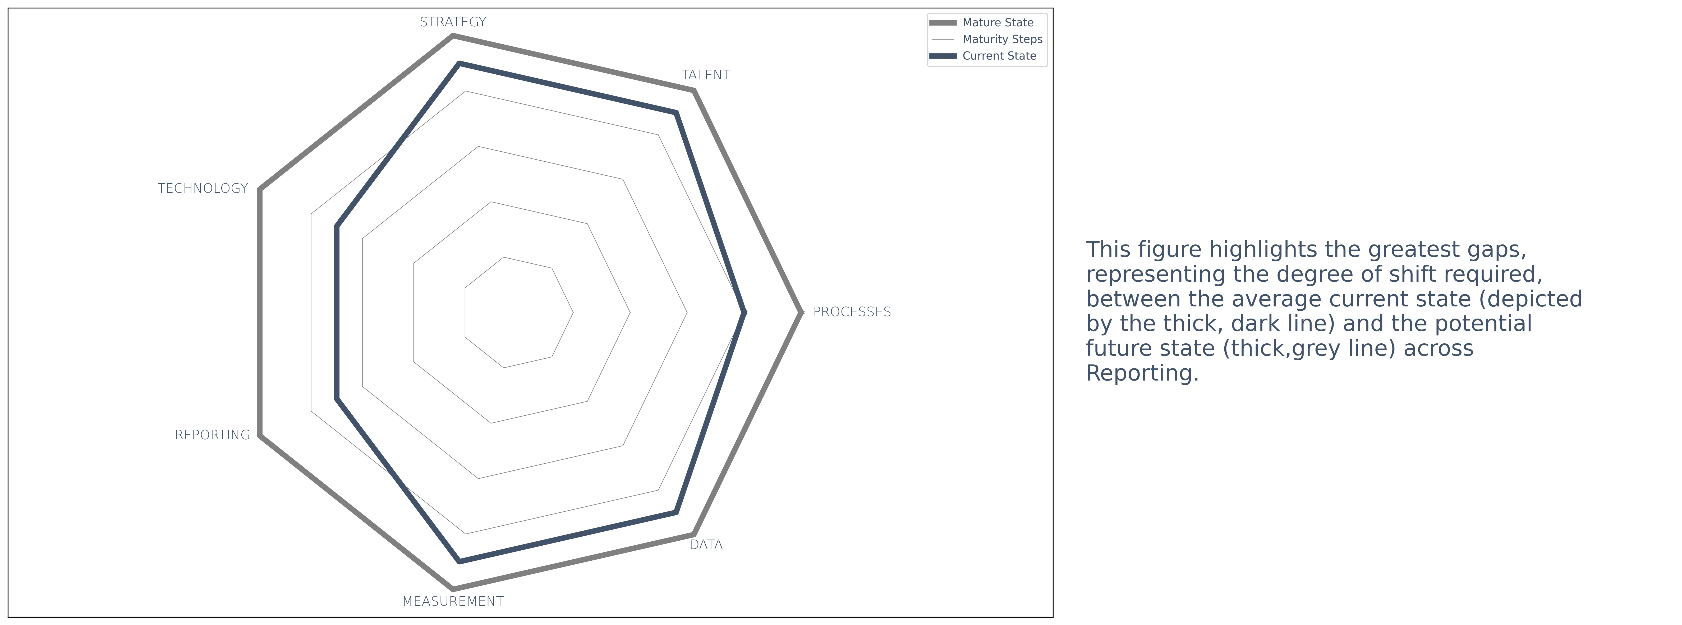
Overview
The figure below provides a summary view of the current state (where we are now) and future state (where we want to get to) across the capability dimensions. Where more than one element is included within a dimension, the average across all contributing elements is reflected, with equal weighting. This is followed by a detailed breakdown of the capability assessment results, considering key recommendations for actions per capability dimension, and each of the elements that make up the respective dimensions.
Capability ASSESSMENT Report

Slide 8
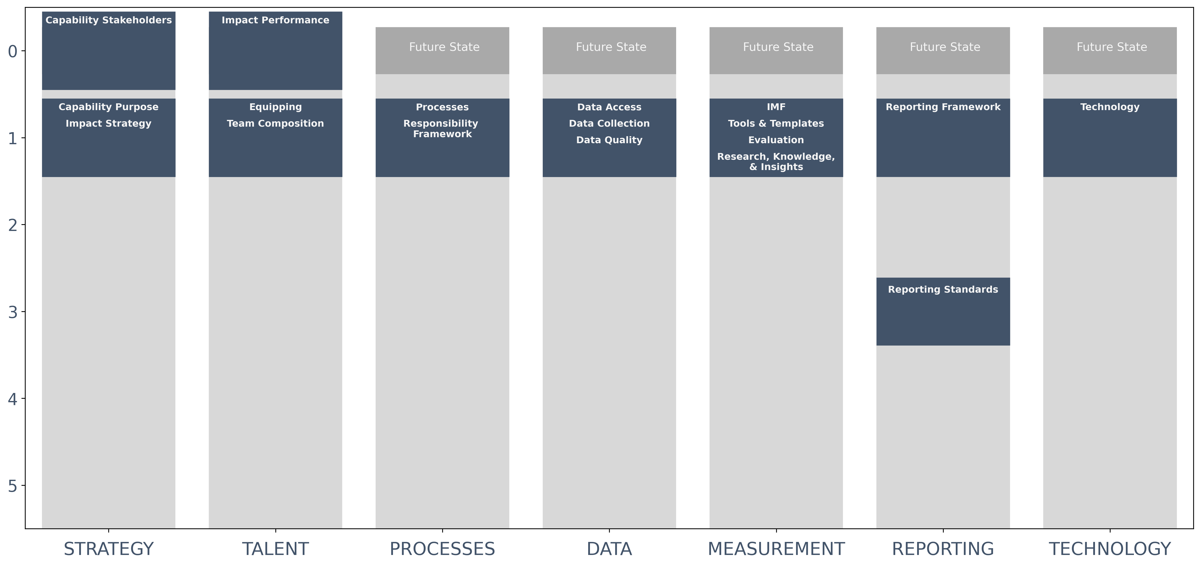
Steps to Future State
The figure below provides a more detailed view of the gaps (reflected as the number of ‘steps’) between current and future state in each element of the Impact Management Capability dimensions. The elements that are driving the greater degree of shift required between current and future states are:
Capability Purpose, Impact Strategy, Equipping, Team Composition, Processes, Responsibility Framework, Data Access,
Data Collection, Data Quality, IMF, Tools & Templates, Evaluation, Research, Knowledge, & Insights, Reporting Standards, and Technology.
No. of Steps between current state and future state
Capability Dimension
Capability ASSESSMENT Report

Slide 9
SUMMARY Roadmap
Summary of key actions, highlighted through the recommendations:
1.
Refine impact strategy based on insisghts from a full implementaiton of life-cycle and insights gained.
2.
Ensure all programmes / areas of work have aligned Impact measurement Frameworks and capacity to execute to paln.
3.
Ensure data access, collection, and quality are executed and managed to plan. Implement any improvements based on implemention
experience, feedback and lessons learnt.
4.
Continue to recruit and build capacity of Impact management capability and its sub-capabilities to support continuous equipping and integrated
performance management across the organisation.
5.
Ensure consistent implementation of processes led by IM capability; and socialise acros the organisation. Implement responsibility
assignment framework to support process execution.
6.
Adopt and implement reporting framework and standards to guide consistent reporting across the organisation.
7.
Equip all teams to utilise adopted technology across the organisation. Explore, evaluate and introduce new technology as required based
on implementation lessons and insights.
Capability ASSESSMENT Report

Slide 10
RESULTS AND RECOMMNEDATIONS
3

Slide 11
RESULTS: STRATEGY
1

Slide 12
KEY TERMS: Strategy
Impact strategy
An impact strategy clearly outlines your organisation's purpose. It is a detailed roadmap to achieve your intended impact and provides a long-term vision of how such impact will be achieved and measured to determine success (Investment Impact Index, 2019). This could take the form of a Theory of Change, impact thesis or something similar.
Capability Purpose
Each capability (defined as processes, tools, skills, behaviours, and organisation that help an organisation deliver an outcome) within an organisation has a purpose – a role to play in relation to achieving the organisation’s purpose and strategic objectives (PWC, 2019). Ideally, this purpose should be clearly aligned with the organisation's strategy and desired impact (Turner, Crawford & Hobbs, 2004).
Capability Stakeholders
Stakeholders are groups of people who gain direct benefits from or are affected by your organisation's operations (Benn, Abratt & O'Leary, 2016). Stakeholders could include shareholders, investors, beneficiaries, customers, employees, suppliers, financial supporters, and communities. In this case, we are considering the stakeholders served and / affected your impact management capability.

Slide 13
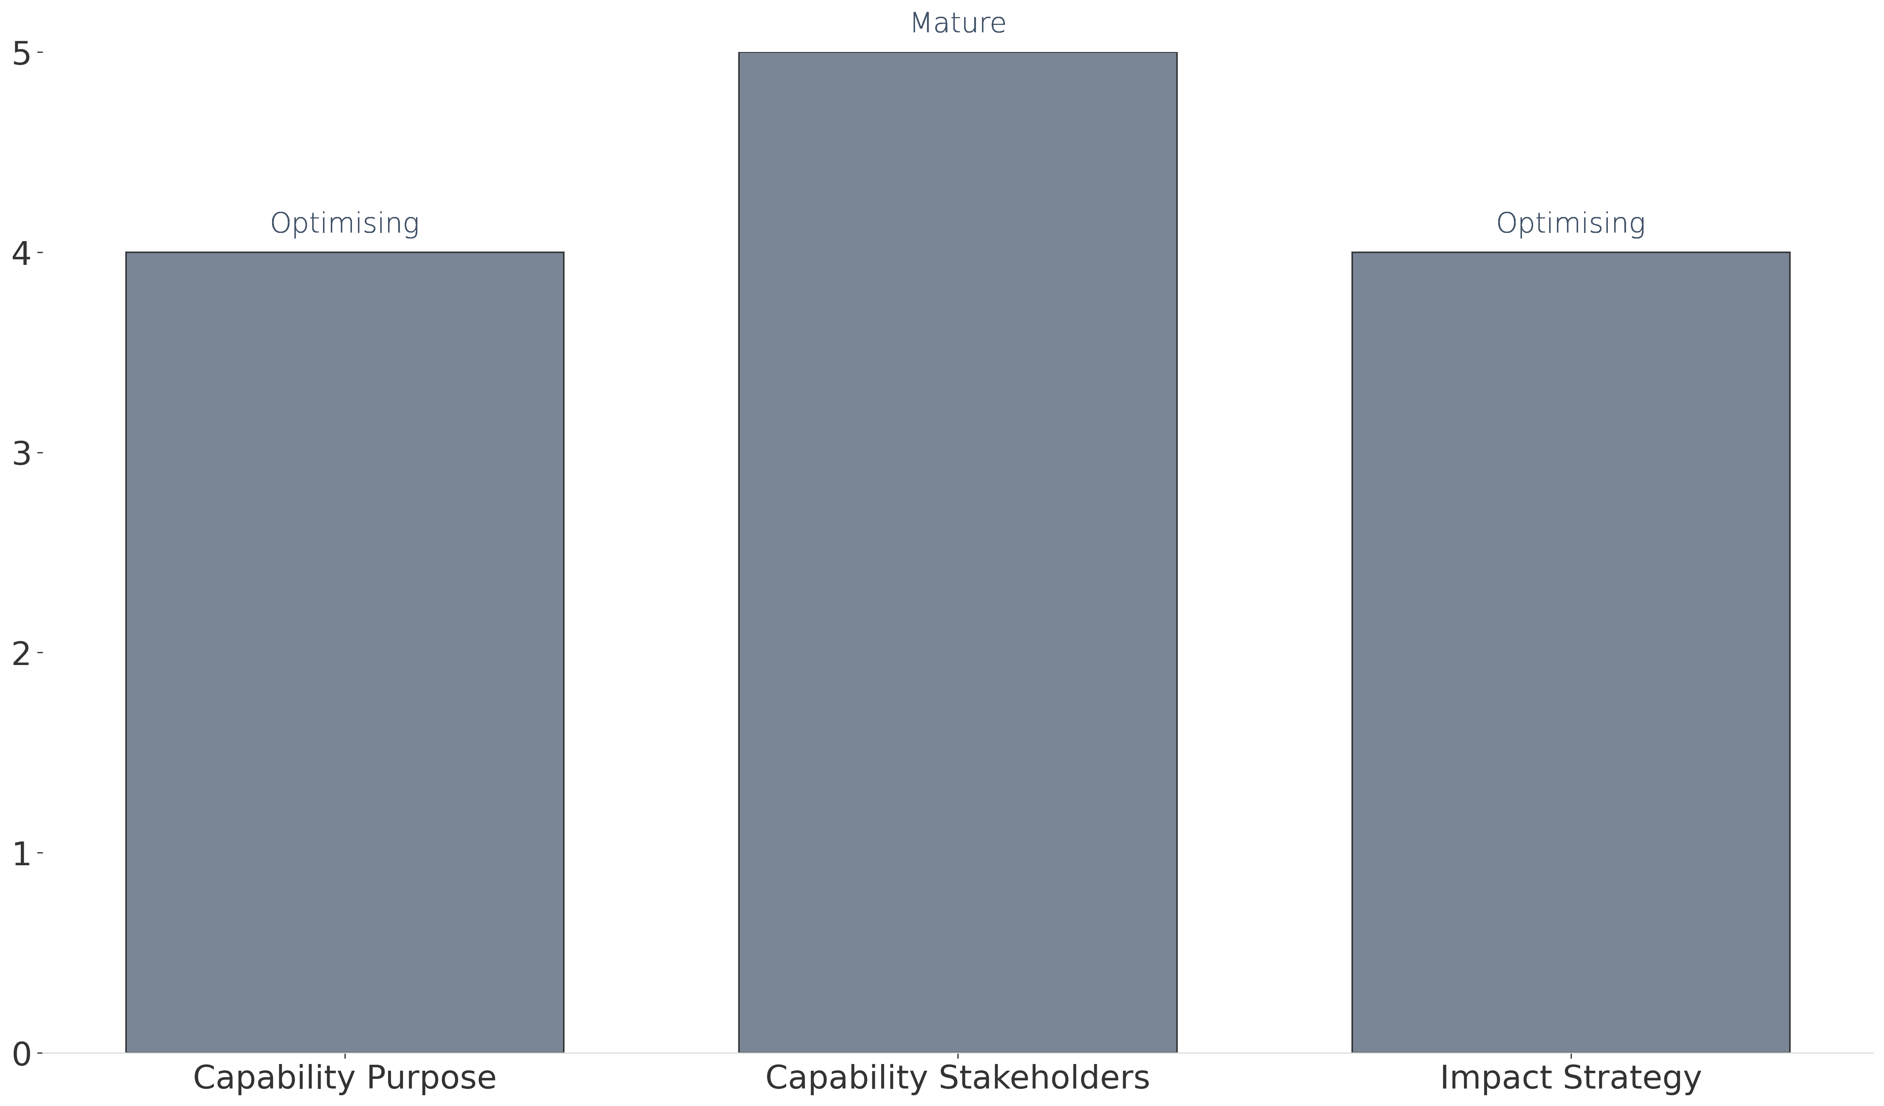
Results: Strategy
The graph below reflects your current stage of maturity in relation to strategy and the elements which constitute this dimension.
Legend: Levels of maturity
1. Nascent - little or no formal capability in this area
2. Emerging - Some establishment, but an early-stage / basic level
Maturity level
3. Expanding - Established, but still developing
4. Optimising - Established, applying improvements based on early-stage lessons
5. Mature - Fully-fledged and developed capability
Capability Dimension

Slide 14
Recommendations: Strategy
The table below outlines the recommended actions to close gaps towards intended future state across the Strategy dimension.
As the Impact Management capability is established, the purpose needs to be prioritised, localised and embedded in the
context of the organization and its strategy. Consideration needs to be given to the potential to spin off in the future and
the implications of this for the Impact Management capability and its position within the organization.​
CAPABILITY PURPOSE
CAPABILITY STAKEHOLDERS
IMPACT STRATEGY
Routinely review, update and engage with stakeholders of the Impact Management capability to clarify and clearly
articulate the purpose within the context and operating structure.
Plan a Theory of Change retrospective and review for the end of Year one of implementation to incorporate adaptation
and lessons learnt from implementation in practice, assessing the consistency of the context and driving factors of the
Theory of Change, as well as contextual shifts and changes to assumptions and risks that could trigger strategic shifts. The
review process should seek to engage those with lived experience (such as program staff and partners) implementing on
the ground (those closest to the problem), to understand what is working, what is not working, what needs in the
community are hindering progress and what needs are/remain a priority in order to build capacity and resilience within
individuals and communities served. This should help to strengthen the clarity and case that can be made through the
Theory of Change for how and why your work will bring the intended change.​ Leveraging stakeholder experience and
expertise will help bring focus and clarity, as well as confidence to funders and partners. This will also ensure the Impact
Strategy remains widely known and socialised, providing a clear focal point to rally around and focus continued effort. ​​
Capability ASSESSMENT Report

Slide 15
RESULTS: TALENT
2

Slide 16
KEY TERMS: TALENT
Team Composition
Team composition refers to the overall mix of characteristics among people in a team. This involves putting together individuals with the relevant skill sets and expertise, to not only help a team accomplish its goals, but to also maximise the team's overall effectiveness (Cooke & Hilton, 2015).
Impact Performance
This refers to how well a person, project, or programme is performing against planned impact goals or objectives (Global Impact Investing Network, 2023a). Various metrics and data points help to provide a view of this performance.
Equipping
This refers to processes, tools, and templates that are created and utilised to support the Impact Management process (Stories for Impact 2024).

Slide 17

Results: TALENT
The graph below reflects your current stage of maturity in relation to talent and the elements which constitute this dimension.
Legend: Levels of maturity
1. Nascent - little or no formal capability in this area
2. Emerging - Some establishment, but an early-stage / basic level
Maturity level
3. Expanding - Established, but still developing
4. Optimising - Established, applying improvements based on early-stage lessons
5. Mature - Fully-fledged and developed capability
Capability Dimension

Slide 18
Recommendations: TALENT
The table below outlines the recommended actions to close gaps towards intended future state across the Talent dimension.
Review and refine standardised templates, tools, processes, and training (collateral) to ensure consistent
implementation of processes lead by the Impact Management Capability. (This can be prioritised once initial
capability design is in place and the capability is established, with a workplan and prioritization of collateral to
develop).​ If recruitment to fulfil the team composition requirements is slow and / a lower job level is required on
a permanent basis, there will be a lag on the development of consistent collateral and training coming from the
Impact Management Capability. This will have a knock-on effect on implementation of impact measurement. ​A
partner could assist initially to finalize specific standardised collateral (templates, tools, processes and training)
to equip teams within the organization. In line with stated objectives, talent within the Impact Management
Capability would also need to develop capacity to maintain and improve this over time and serve the growth and
needs of PBVP (consideration for developing job profiles).
EQUIPPING
IMPACT PERFORMANCE
TEAM COMPOSITION
Work with HR to routinely review and update the individual Impact Performance to accommodate for alignment of
individual scorecards and performance management to the Impact Strategy. This can be a broader exercise for the
way individual performance is considered within.​ Develop a plan to execute and integrate this revised approach -
including required communications and training of talent across all levels of the organization to co-create aligned
individual scorecards and performance management processes accordingly.
Embed processes to review and refine the recruitment plan in line with needs of the capability to continue to
expand and serve its purpose. Develop role descriptions and job profiles for the team reflective of the skills and
competencies required to execute functions and activities in line with the capability design. An option could be to
work with a partner to develop the processes that will guide the Impact Management Capability team. This can
be helpful because building a capability / sub-capability from scratch may require different competencies to those
that are required to maintain and execute processes into the future. This can include initial capacity building a new
team may require to stabilise and work cohesively. ​
Capability ASSESSMENT Report

Slide 19
RESULTS: PROCESSES
3

Slide 20
KEY TERMS: PROCESSES
Processes
Processes are sets or groups of related activities carried out by the organisation (Faugier-Contreras, Guevara-Flores & Hernández-Calderón, 2023). Here we are considering any processes which help an organisation understand, act on, and communicate its impact.
Responsibility framework
A responsibility framework outlines the roles and responsibilities of the processes lead by and / performed within the Impact Management Capability (Zein, 2010).

Slide 21
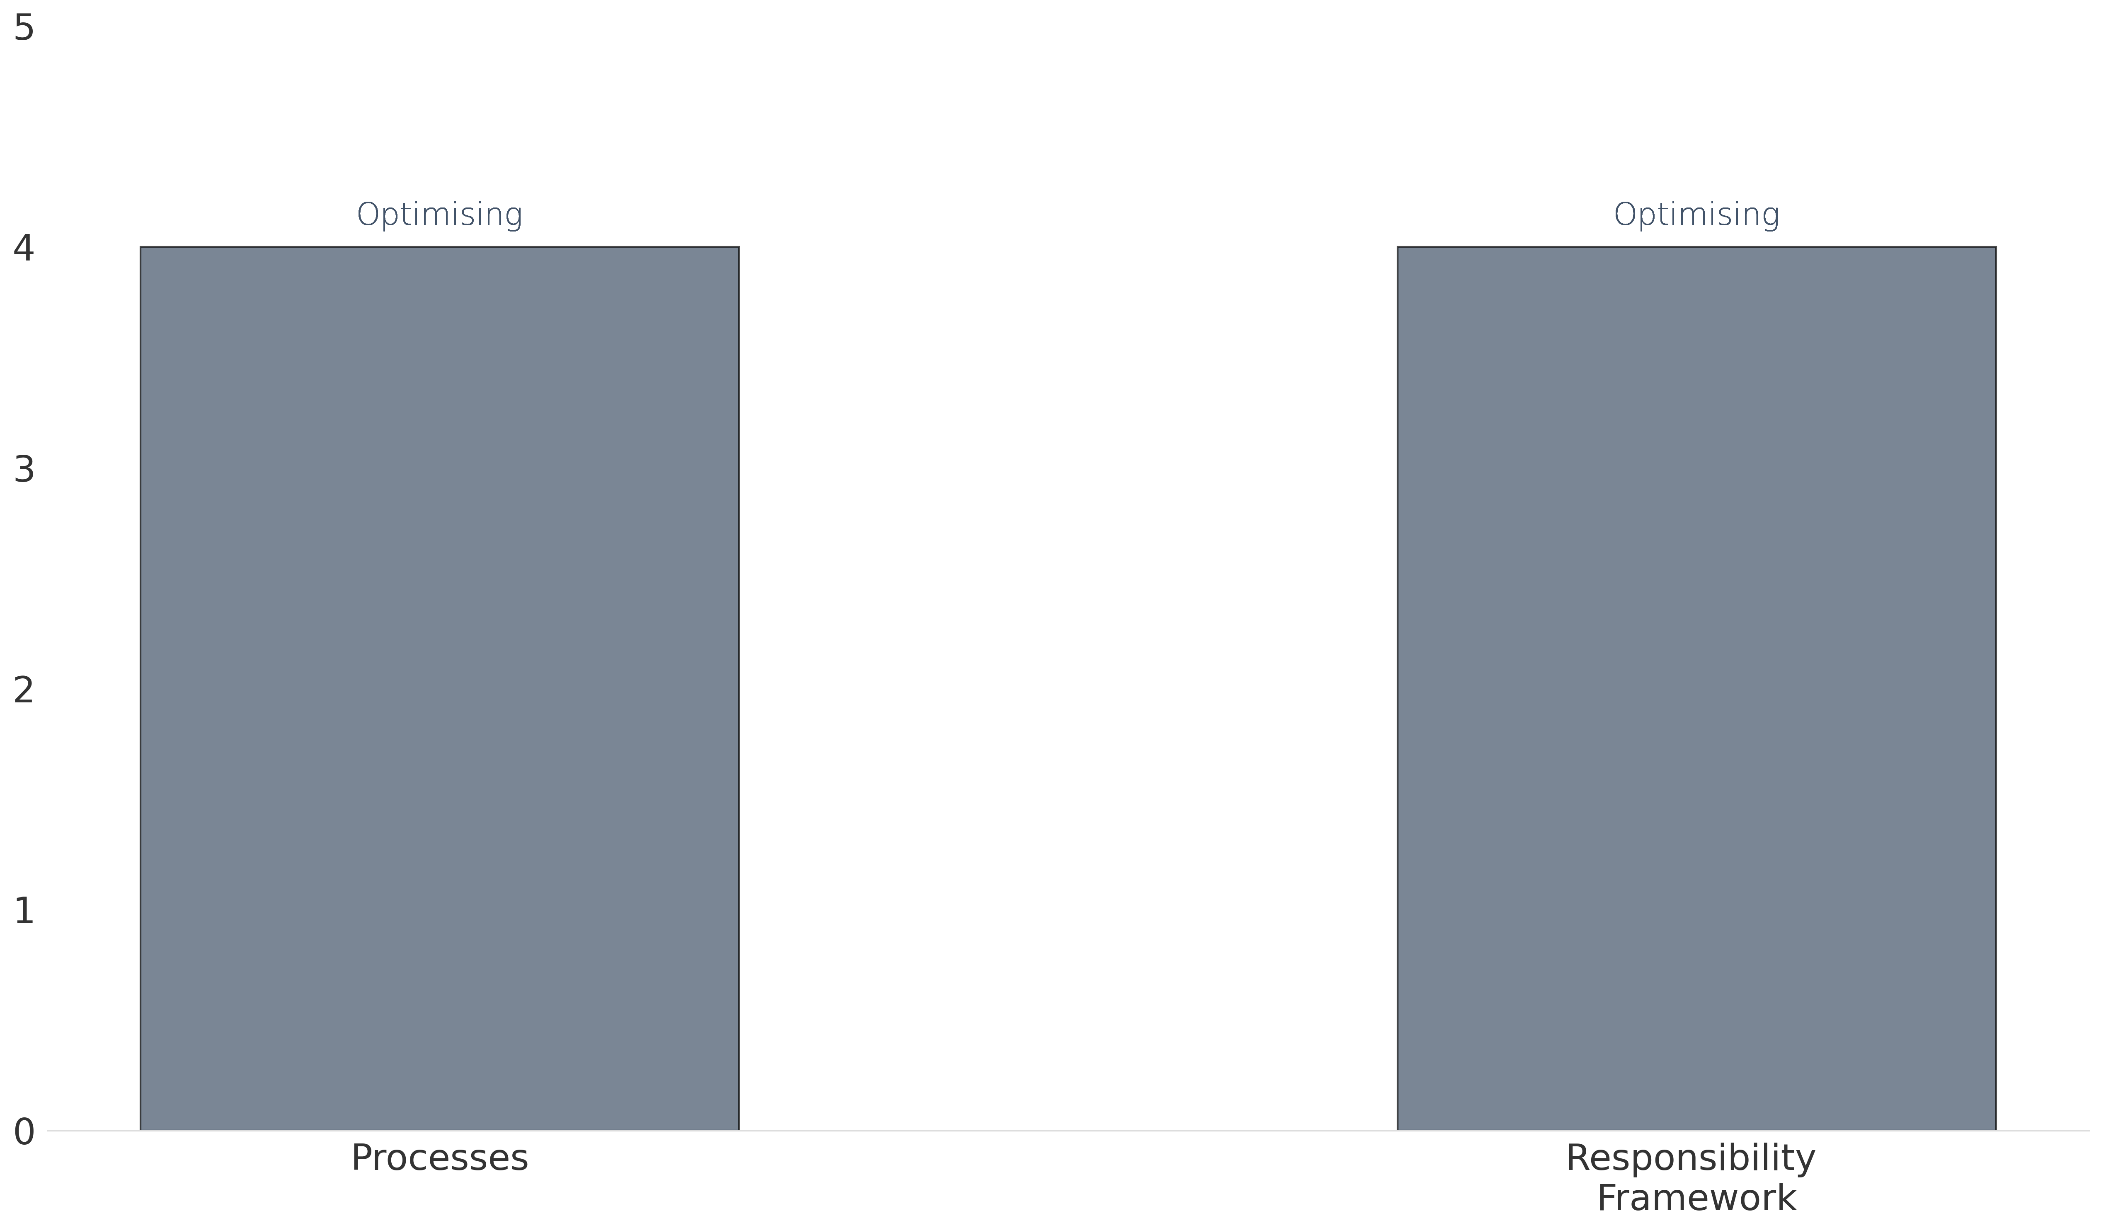
Results: PROCESSES
The graph below reflects your current stage of maturity in relation to processes and the elements which constitute this dimension.
Legend: Levels of maturity
1. Nascent - little or no formal capability in this area
2. Emerging - Some establishment, but an early-stage / basic level
Maturity level
3. Expanding - Established, but still developing
4. Optimising - Established, applying improvements based on early-stage lessons
5. Mature - Fully-fledged and developed capability
Capability Dimension

Slide 22
Recommendations: PROCESSES
The table below outlines the recommended actions to close gaps towards intended future state across the Processes dimension.
Review and refine the capability design process to develop the capability by unpacking: the ‘job-to-be-done’ by the Impact
Management Capability; defining the capability model (including the Impact Management sub-capabilities needed); define
the boundaries of the Impact Management Capability (what it does do and what it doesn’t do); identify and define the
high-level processes this capability will need to lead in order to fulfil the purpose and stakeholder needs; determine the
responsibility assignment framework PACE . See example of PACE application. ​Develop more detailed processes once the
team is in place. The capability design process above will assist to inform the development of role profiles (based on PACE);
and workplans.​ An option could be to work with a partner to initially develop the processes that will guide the Impact
Management Capability team. Socialise the responsibility assignment framework and processes across all levels of the
organziation to ensure it is understood and can support effective work across capabilities and consistent execution of
processes.​ Plan for a retrospective review of processes and PACE, ensure actions for refinement based on lessons learnt
are planned for.
PROCESSES & RESPONSIBILITY FRAMEWORK
Capability ASSESSMENT Report

Slide 23
RESULTS: DATA
4

Slide 24
KEY TERMS: DATA
Data access
This refers to how readily accessible and available data is to enable relevant internal and external stakeholders to utilise data to make decisions and meet their needs (National Academy of Sciences et al., 2009).
Data collection
Data collection is the process of gathering information which will enable one to answer relevant questions and evaluate outcomes (Harwood & Vang, 2009).
Data quality
Data quality considers how well the data management system reflects the real world. Dimensions of data quality include accuracy, reliability, completeness, precision, timeliness, integrity, and confidentiality (Brown, 2007).

Slide 25
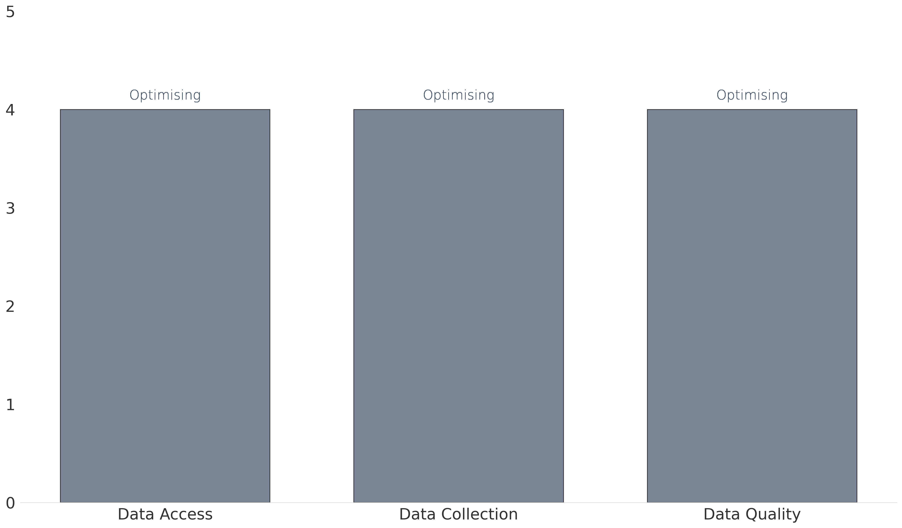
Results: DATA
The graph below reflects your current stage of maturity in relation to data and the elements which constitute this dimension.
Legend: Levels of maturity
1. Nascent - little or no formal capability in this area
2. Emerging - Some establishment, but an early-stage / basic level
Maturity level
3. Expanding - Established, but still developing
4. Optimising - Established, applying improvements based on early-stage lessons
5. Mature - Fully-fledged and developed capability
Capability Dimension

Slide 26
Recommendations: DATA
The table below outlines the recommended actions to close gaps towards intended future state across the Data dimension.
Work together with enabling capabilities such as IT to determine where data needs to end up to ensure it can be accessed and
used by the right people at the right time, e.g. decision-makers and those who are contributing to, learning about and improving
the work of the organization and / programmes. Utilise the Impact Measurement and Reporting Frameworks (once developed)
to review and / identify the data access needs and timing that users have to inform the above. A review of user requirements
will inform data architecture and supporting processes for future. ​Ensure any data access rights / requirements are identified
and planned for (may include policies and access controls to protect data assets and meet regulatory requirements) with
appropriate systems, processes and people to remove bottlenecks to information access. ​
DATA ACCESS
DATA COLLECTION
DATA QUALITY
Review and refine data collection tools, types of data collected and processes using the Impact Strategy and Impact
Measurement framework to select fit-for-purpose and fit-for context mix of tools, data types (and range to support
triangulation and participation), methods and processes. Define ethical considerations and standards for data collection
considering issues of consent, respect and care for protection and use of personal information. These may be governed by
social norms and expectations, but in some cases may have legal implications and may require policies and protocols to
support (e.g. considerations and implications of working with children and also collecting data indirectly).
Review and refine the impact data architecture – the models, rules, and policies that will govern how impact data is captured,
processed and stored. ​Review and refine data quality and minimum standards to ensure results are an accurate reflection of
what has occurred. Socialise data architecture, quality standards and processes across all levels of the organization and data
contributors to ensure widely understood and executed accordingly maintain data governance and quality assurance.
Capability ASSESSMENT Report

Slide 27
RESULTS: MEASUREMENT
5

Slide 28
KEY TERMS: MEASUREMENT
Impact Measurement Framework
An impact measurement framework builds on a Theory of Change by identifying the data which should be collected to understand, assess, and illustrate your impact (Spark Strategy, 2023). It includes measures that your organisation will use to evaluate the change that comes about as a result of your activities.
Tools and templates
These are the tools and templates that enable your team to implement your impact measurement framework. These may include templates, user guides, and process notes to guide implementation of impact measurement to plan (Global Impact Investing Network, 2023b).
Evaluation
There are many types of evaluation, and so defining a particular type of evaluation can be difficult. However, what is common across all types of evaluation is evaluative thinking. Evaluative thinking can be defined as critical thinking and reflection which is primarily motivated by curiosity and inquisitiveness, as well as valuing evidence (CDC, 2018). This includes identifying assumptions, asking questions, and continuous commitment to learning (Archibald, 2013). This assessment therefore utilises the term 'evaluation' broadly, and as referring to evaluative thinking.
Research, knowledge and insights
This may include research into underlying theory, best practices, market research, insights from evaluations, and knowledge from data (McKinsey & Company, 2022).

Slide 29
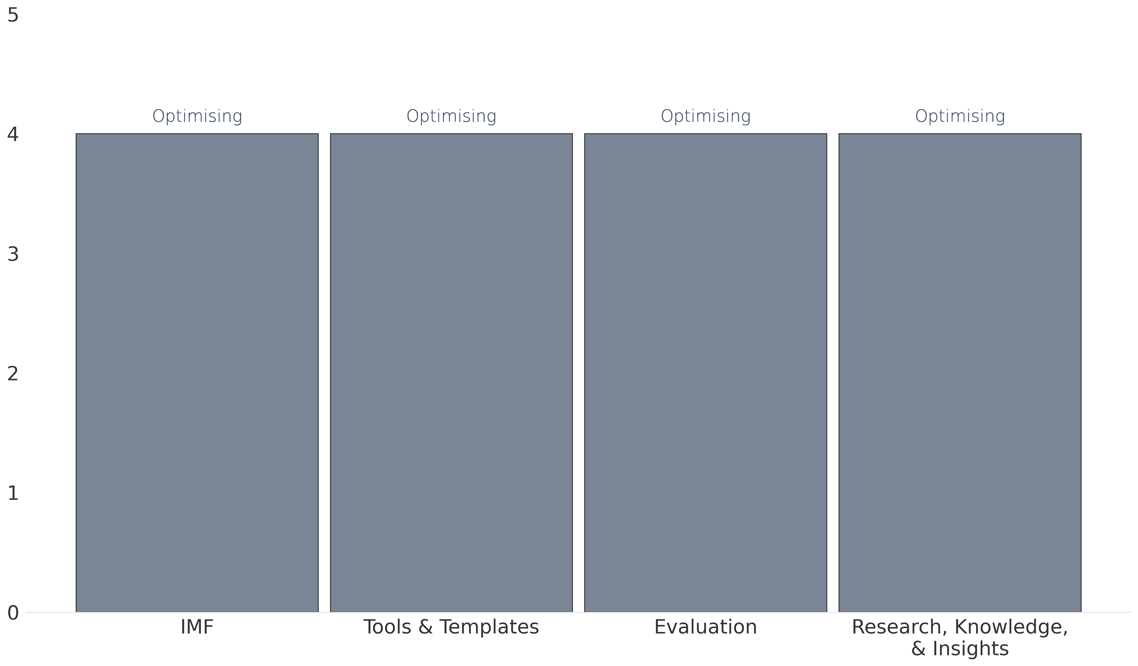
Results: MEASUREMENT
The graph below reflects your current stage of maturity in relation to measurement and the elements which constitute this dimension.
Legend: Levels of maturity
1. Nascent - little or no formal capability in this area
2. Emerging - Some establishment, but an early-stage / basic level
Maturity level
3. Expanding - Established, but still developing
4. Optimising - Established, applying improvements based on early-stage lessons
5. Mature - Fully-fledged and developed capability
Capability Dimension

Slide 30
Recommendations: MEASUREMENT 1/2
The table below outlines the recommended actions to close gaps towards intended future state across the Measurement dimension.
Review and refine well-defined indicators that are consistent (build time series data to track and understand performance
over time), and clearly stated with specific parameters within the Impact Measurement Framework (IMF) – for each level
of the Theory of Change. Consider the implications of Impact Measurement Framework implementation on processes lead
by the Impact management Capability, as well as performance management (scorecards) and technology.​
Impact Measurement Framework
Tools and Templates
Review and refine the templates and training (see ”equipping” in Talent dimensions) required to socialise the Impact
Measurement framework and associated tools and processes across all levels of the organization and enable execution to
plan. Review and refine a plan for development of these consistent templates and training collateral (the comprehensive
set) and roll-out to support effective and consistent implementation. Develop mechanisms for routine review and reflection,
incorporating mechanisms for stakeholder feedback. ​​
Capability ASSESSMENT Report

Slide 31
Recommendations: MEASUREMENT 2/2
The table below outlines the recommended actions to close gaps towards intended future state across the Measurement dimension.
Finalize and implement regular evaluation and evaluative thinking practice within the initiative. Finalize and implement Key
evaluation questions that can be embedded into reflective processes and applied to monitoring data resulting from execution
of the Impact Measurement Framework. Consider existing, recognised frameworks that can be leveraged to adopt evaluation
questions into reflective practice and organizational learning. See the OECD DAC evaluation criteria and the IMP 5 Dimensions
of Impact for existing questions that can be leveraged. Socialise across PBVB and include budget allocations to incorporate
evaluation and evaluative thinking and practice.
EVALUATION
RESEARCH, KNOWLEDGE, AND INSIGHTS
Review and refine the research strategy (the ‘job-to-be-done’ for research) as a sub-capability and what is required to meet
the objectives of the Impact Strategy, stakeholder needs, as well as prospective investor needs to build trust and confidence,
and it turn, mobilise resources. Defining the level of research required will assist to determine the level of internal capability
required, also consider research partnerships as a way to fulfil research requirements without scaling internal capacity. Develop
secondary sources of research information that are relevant for the context and environment and can be used to inform program
design.​​ Develop a library and / schedule of preferred secondary research sources (including research conducted by partners that
can be leveraged).​
Capability ASSESSMENT Report

Slide 32
RESULTS:REPORTING
6

Slide 33
KEY TERMS: REPORTING
Reporting framework
A reporting framework is a standardised system used to consistently report performance (Idowu et al., 2013).
Reporting standards
These standards provide principles for preparing reports and determine the types and amounts of information that must be provided to users so that they can make informed decisions (Global Reporting, 2024).

Slide 34
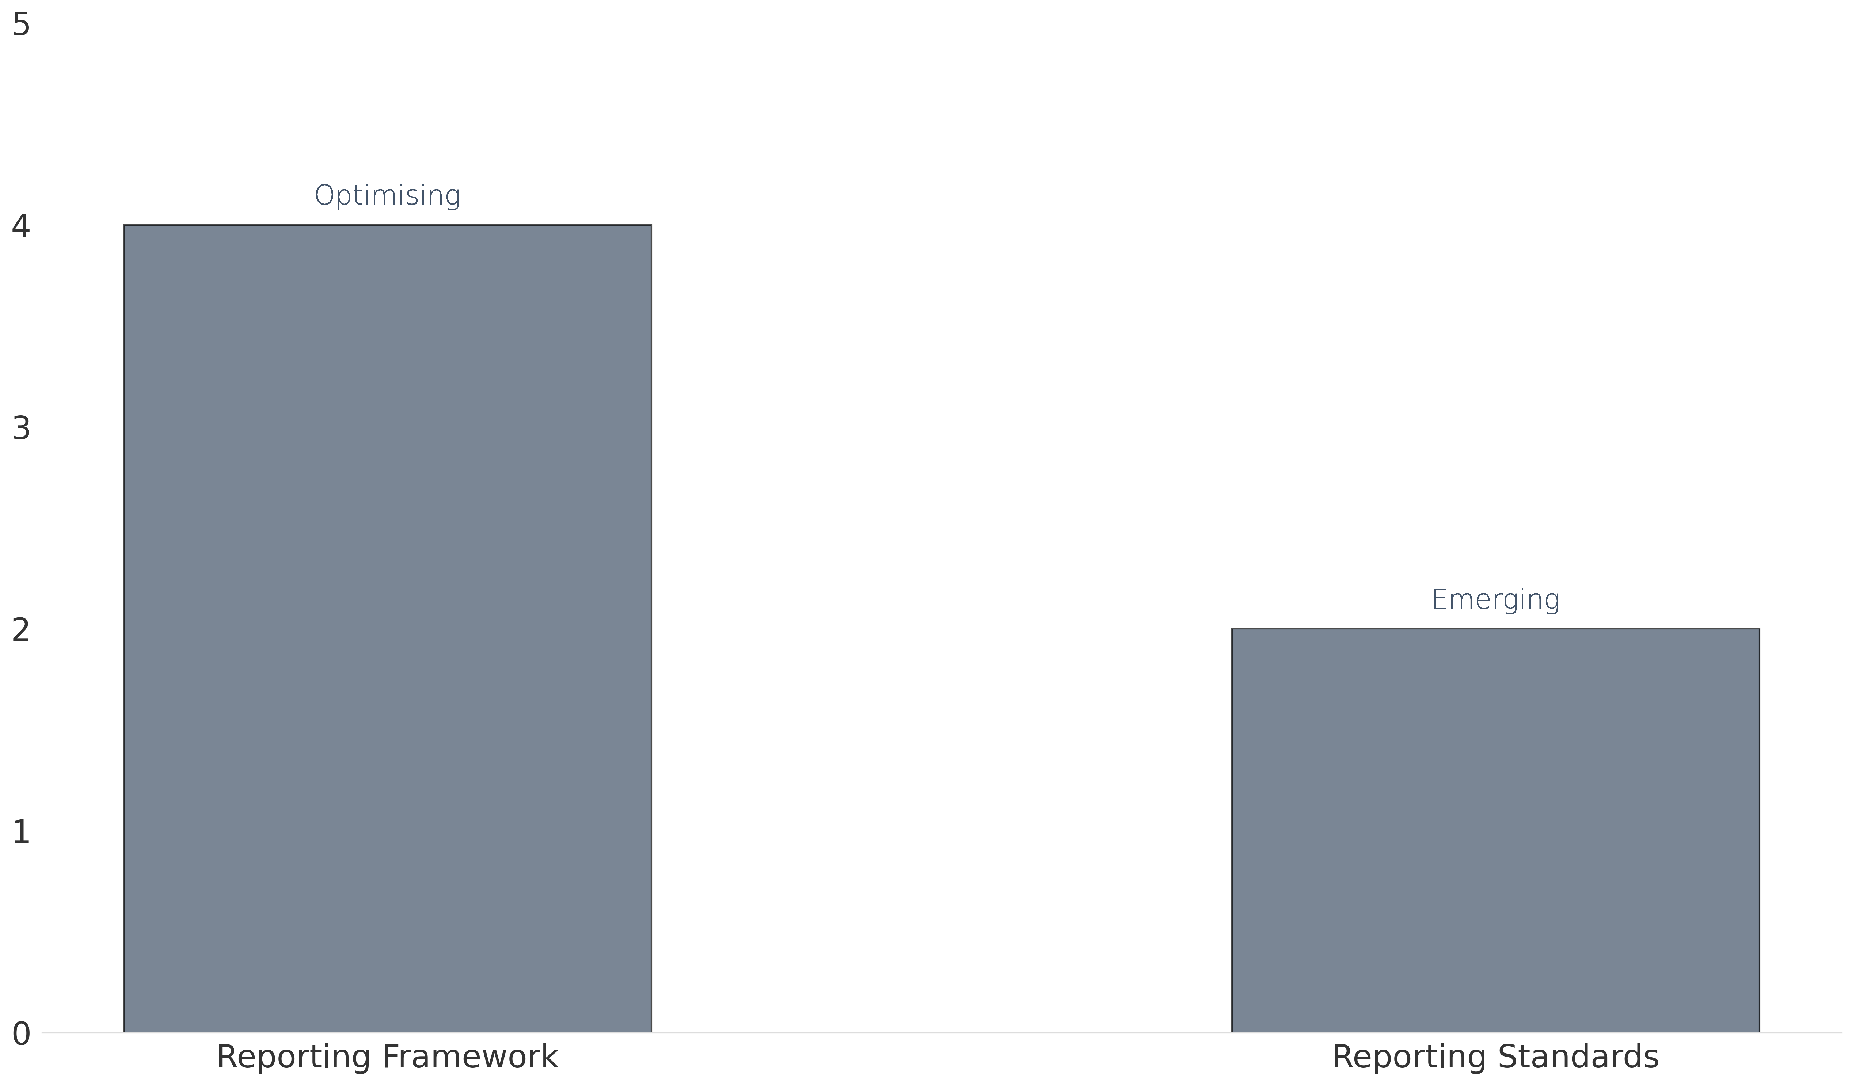
Results: REPORTING
The graph below reflects your current stage of maturity in relation to reporting and the elements which constitute this dimension.
Legend: Levels of maturity
1. Nascent - little or no formal capability in this area
2. Emerging - Some establishment, but an early-stage / basic level
Maturity level
3. Expanding - Established, but still developing
4. Optimising - Established, applying improvements based on early-stage lessons
5. Mature - Fully-fledged and developed capability
Capability Dimension

Slide 35
Recommendations: Reporting
The table below outlines the recommended actions to close gaps towards intended future state across the Reporting dimension.
Review and refine the reporting framework to guide consistent reporting across the organization, that will proactively meet
stakeholder needs, is aligned to Impact Strategy and meeting regulatory and other requirements.
REPORTING FRAMEWORK
REPORTING STANDARDS
​Select the standards that are relevant and develop plans for integration into processes, measurement, data and talent
competencies.​ Socialise reporting standards across the organization and relevant stakeholders to increase quality of
communication and materiality of disclosures.
Capability ASSESSMENT Report

Slide 36
RESULTS: TECHNOLOGY
7

Slide 37
KEY TERMS: TECHNOLOGY
Technology
Here, technology refers to using standardised tools and/or applications to support the processes and systems outlined throughout this report (Carvalho et al., 2021). These are technological means for collecting, measuring and/or illustrating impact.

Slide 38
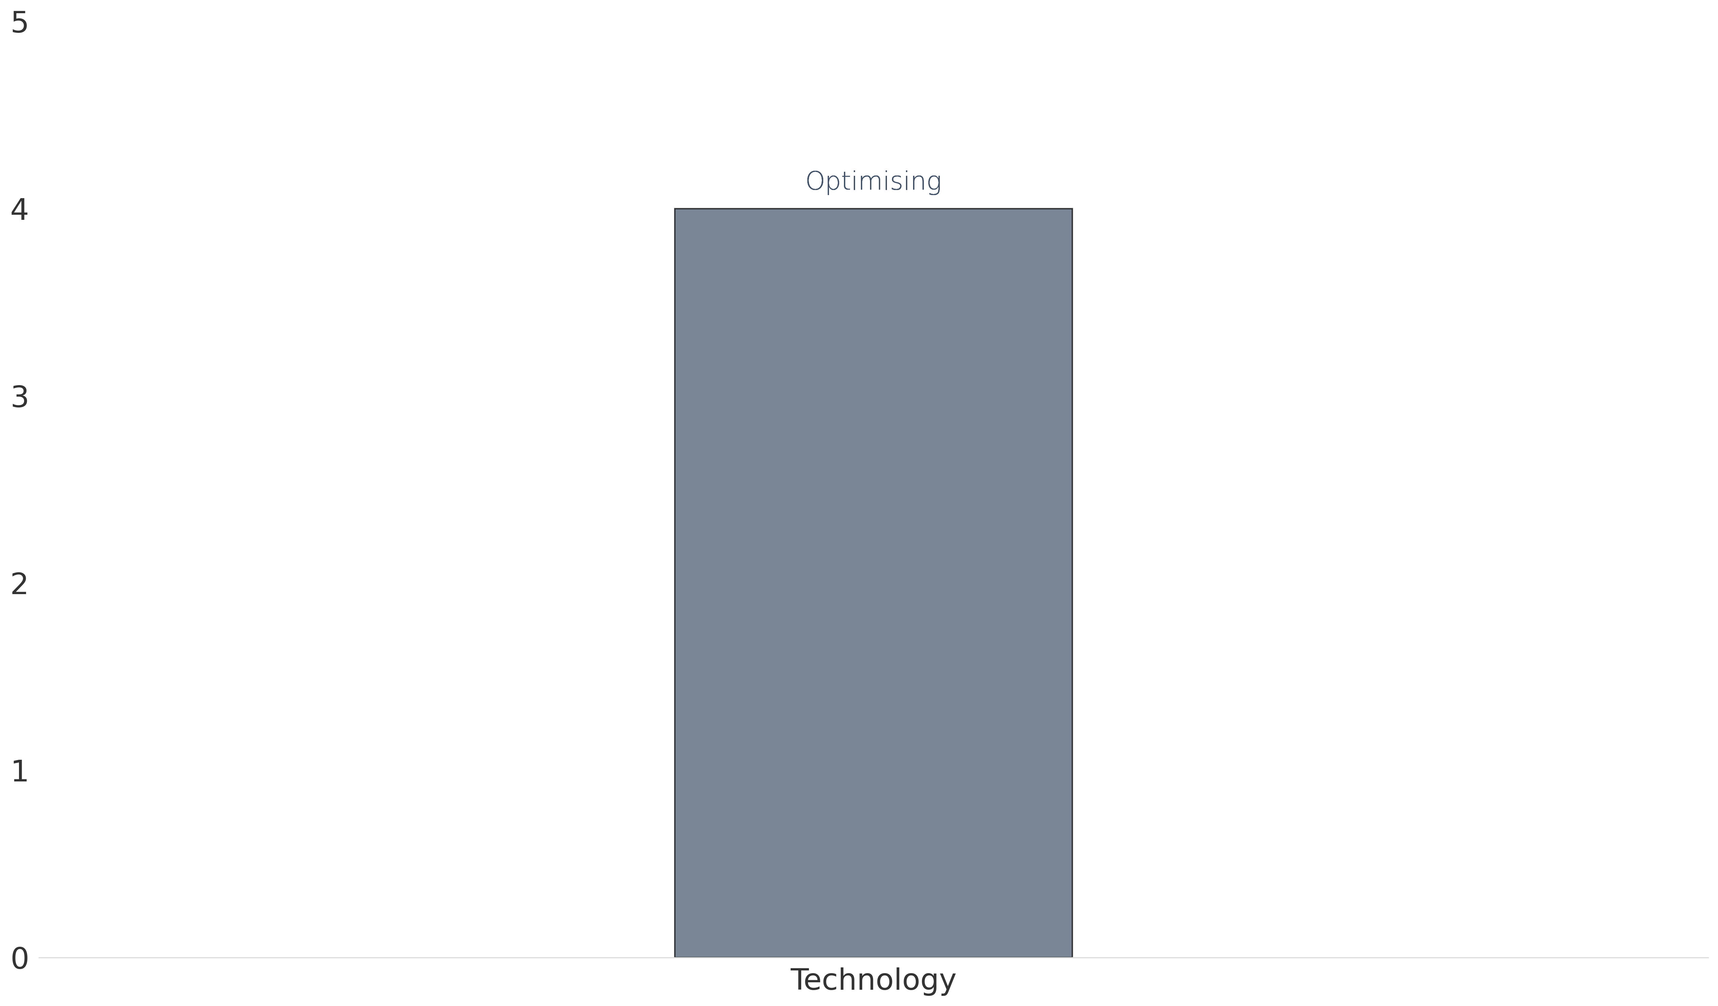
Results: TECHNOLOGY
The graph below reflects your current stage of maturity in relation to technology and the elements which constitute this dimension.
Legend: Levels of maturity
1. Nascent - little or no formal capability in this area
2. Emerging - Some establishment, but an early-stage / basic level
Maturity level
3. Expanding - Established, but still developing
4. Optimising - Established, applying improvements based on early-stage lessons
5. Mature - Fully-fledged and developed capability
Capability Dimension

Slide 39
Recommendations: TECHNOLOGY
The table below outlines the recommended actions to close gaps towards intended future state across the Technology dimension.
Implemented tools and / applications are evaluated and changes needed are explored. Teams are equipped to use tools and /
applications. Best practices for tools and / applciations are set up.
Technology
Capability ASSESSMENT Report

Slide 40
NEXT STEPS
4

Slide 41
Next steps
It will be important for you to consider the extent to which these shifts will serve the broader organization to be able to make decisions as to the structure of the organization, with the inclusion of the Impact Management Capability.
We recommend reviewing the recommendations based on the future state pathway and plan timeframes for implementing prioritised elements, including priorities and actions for the next year. Identify implications for operational planning and budget processes.
Execute your plan and make positive shifts towards the key elements of the Impact Management Capability and its potential to realise strategic benefit for your organization and its stakeholders.
Hold yourselves accountable to your plans and track progress against implementation.
Review overall progress at the end of each year, and establish progress objectives for the following year, using the maturity assessment matrix.
Relativ is able to assist with capacity building in many of the areas of recommendation and would welcome the opportunity to discuss any specific elements.
Capability ASSESSMENT Report

Slide 42
THANK YOU for JOINinG us on the JOURNEY.
GABRIELLE HABBERTON
+27 72 746 9467
gabrielle.habberton@relativ.co.za
www.relativimpact.com

